Slide 1
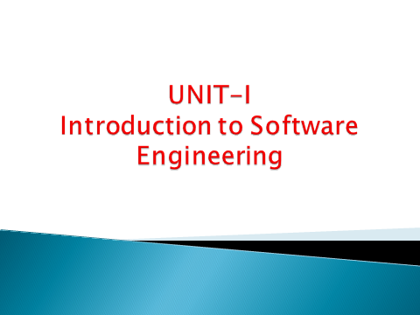

Slide 2

Evolving Role of Software
  Hardware vs. Software
  Software characteristics
Changing nature of software
Software Myths

Slide 3
Software is a product
Transforms information - produces, manages, acquires, modifies, displays, or transmits information
Delivers computing potential of hardware and networks
Software is a vehicle for delivering a product
Controls other programs (operating system)
Effects communications (networking software)
Helps build other software (software tools & environments)

Slide 4

Software can define as:
  Instruction – executed provide desire features, function & performance.
  Data structure – to adequately manipulate operation.
  Documents – operation and use of the program.
Software products may be developed for a particular customer or may be developed for a general market.
  Software products may be
    Generic - developed to be sold to a range of different customers e.g. PC software such as Excel or Word.
    Bespoke (custom) - developed for a single customer according to their specification.

Slide 5

Hardware | Software
Manufactured wear out Built using components Relatively simple | Developed/ engineered deteriorate Custom built Complex

Slide 6

Once a hardware product has been manufactured, it is difficult or impossible to modify. In contrast, software products are routinely modified and upgraded.
In hardware, hiring more people allows you to accomplish more work, but the same does not necessarily hold true in software engineering.
Unlike hardware, software costs are concentrated in design rather than production.

Slide 7

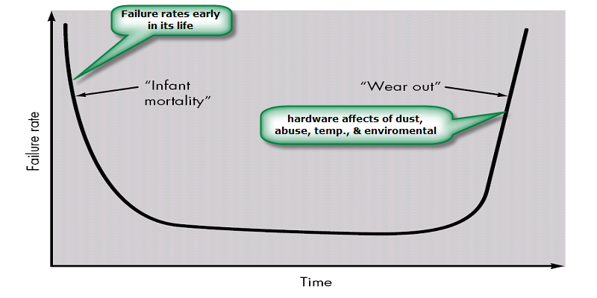

Slide 8
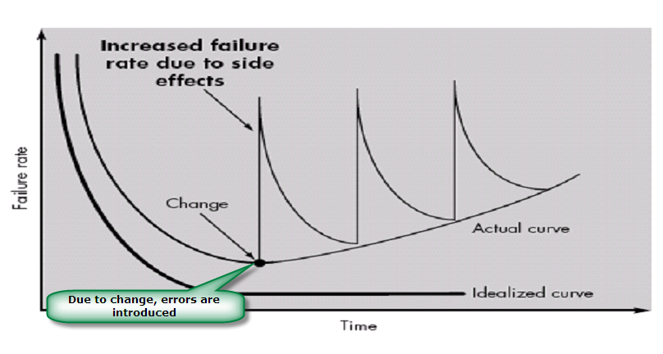
When a hardware component wears out, it is replaced by a spare part.
There are no software spare parts. Every software failure indicates an error in design or in the process through which design was translated into machine executable code. Therefore, software maintenance involves considerably more complexity

Slide 9
Hardware products typically employ many standardized design components.
Most software continues to be custom built.
The software industry does seem to be moving (slowly) toward component-based construction.

Slide 10

Software is developed or engineered; it is not manufactured.
Software does not “wear out” but it does deteriorate.
Software continues to be custom built, as industry is moving toward component based construction.

Slide 11

System software
Application software
Engineering/scientific software
Embedded software
Product line software
Web applications
Artificial intelligence software

Slide 12
System Software:
System software is a collection of programs written to service other programs.
It is characterized by heavy interaction with computer hardware; heavy usage by multiple users; concurrent operation that requires scheduling, resource sharing, and sophisticated process management; complex data structures; and multiple external interfaces.
Ex. Compilers, operating system, drivers etc.
Application Software :
Application software consists of standalone programs that solve a specific business need.
Application software is used to control the business function in real-time.
Engineering /Scientific software:
Characterized by "number crunching" algorithms.
Applications range from astronomy to volcano logy, from automotive stress analysis to space shuttle orbital dynamics, and from molecular biology to automated manufacturing.
Ex. Computer Aided Design (CAD), system stimulation etc.

Slide 13
Embedded Software:
It resides in read-only memory and is used to control products and systems
Embedded software can perform limited and esoteric functions. (understood by only a small group).
Ex. keypad control for a microwave oven.
Product line software:
Designed to provide a specific capability for use by many different customers, product line software can focus on a limited and esoteric marketplace.
Ex. Word processing, spreadsheet, CG, multimedia, etc.
Web Applications:
Web apps can be little more than a set of linked hypertext files.
It evolving into sophisticated computing environments that not only provide standalone features, functions but also integrated with corporate database and business applications.
Artificial Intelligence software
AI software makes use of non-numerical algorithms to solve complex problems that are not amenable to computation or straightforward analysis
Ex. Robotics, expert system, game playing, etc.

Slide 14
Definition: Beliefs about software and the process used to build it. Myths have number of attributes that have made them insidious (i.e. dangerous).
Misleading Attitudes - caused serious problem for managers and technical people.
Management myths
Managers in most disciplines, are often under pressure to maintain budgets, keep schedules on time, and improve quality.
Myth1: We already have a book that's full of standards and procedures for building
software, won't that provide my people with everything they need to know?
Reality :
Are software practitioners aware of existence standards?
Does it reflect modern software engineering practice?
Is it complete? Is it streamlined to improve time to delivery while still maintaining a focus on quality?

Slide 15
Myth2: If we get behind schedule, we can add more programmers and catch up
Reality: Software development is not a mechanistic process like manufacturing. Adding people to a late software project makes it later.
People can be added but only in a planned and well-coordinated manner
Myth3: If I decide to outsource the software project to a third party, I can just relax and let that firm build it.
Reality: If an organization does not understand how to manage and control software projects internally, it will invariably struggle when it outsource software projects

Slide 16
Customer Myths
Customer may be a person from inside or outside the company that has requested software under contract.
Myth: A general statement of objectives is sufficient to begin writing programs— we can fill in the details later.
Reality: A poor up-front definition is the major cause of failed software efforts. A formal and detailed description of the information domain, function, behavior, performance, interfaces, design constraints, and validation criteria is essential. These characteristics can be determined only after thorough communication between customer and developer.
Myth: Project requirements continually change, but change can be easily accommodated because software is flexible.
Reality: Customer can review requirements and recommend modifications with relatively little impact on cost. When changes are requested during software design, the cost impact grows rapidly. Below mentioned figure for reference.

Slide 17
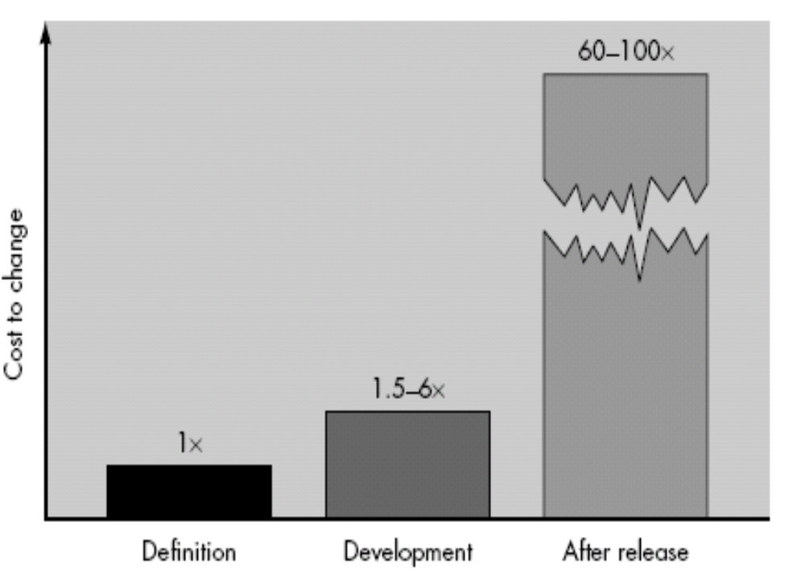

Slide 18
Practitioner's myths
Myth1: Once we write the program and get it to work, our job is done.
Reality: Someone once said that "the sooner you begin 'writing code', the longer it'll take you to get done." Industry data indicate that between 60 and 80 percent of all effort expended on software will be expended after it is delivered to the customer for the first time.
Myth2: Until I get the program "running" I have no way of assessing its quality.
Reality: One of the most effective software quality assurance mechanisms can be applied from the inception of a project—the formal technical review.
Myth3: The only deliverable work product for a successful project is the working program.

Slide 19
Reality: A working program is only one part of a software configuration that includes many elements. Documentation provides a foundation for successful engineering and, more important, guidance for software support.
Myth4 : Software engineering will make us create voluminous and unnecessary documentation and will invariably slow us down.
Reality: Software engineering is not about creating documents. It is about creating
quality. Better quality leads to reduced rework. And reduced rework results in faster delivery times.

Slide 20
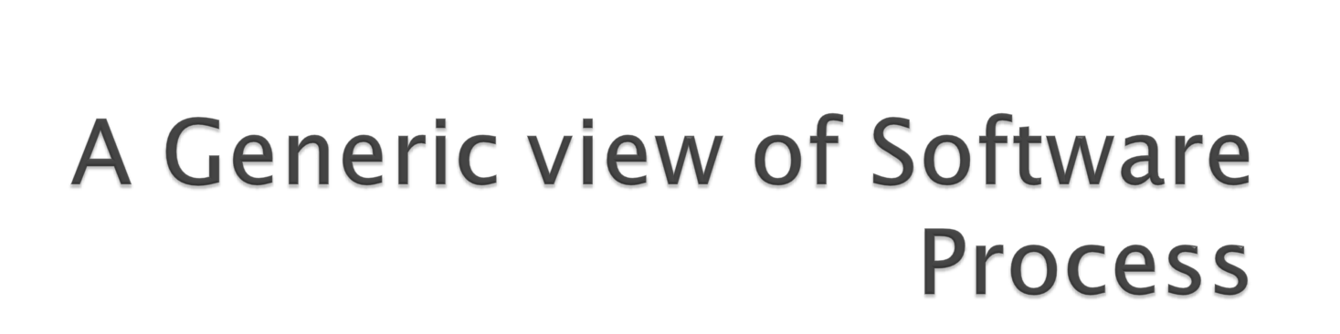

Slide 21

A Layered Technology
A Process Framework
  Generic Process Framework Activities
  Umbrella Activities
CMMI Level

Slide 22

What? A software process –A series of activities that are required to build high-quality software.
Who? Managers, software engineers, and customers.
Steps? A handful of activities are common to all software processes, details vary.
Work product? Programs, documents, and data.

Slide 23
Definition :
  (1) The application of systematic, disciplined, quantifiable approach to the development, operation, and maintenance of software;
  (2) The study of approaches as in (1) above
Software engineers should adopt
  Systematic and organized approach to their work.
  Use appropriate tools and techniques depending on the problem to be solved
  The development constraints and the resources available
Challenge for Software Engineers is to produce high quality software with finite amount of resources & within a predicted schedule

Slide 24

Layered Technology
Tools: CASE preferred
Methods: technical “how to’s”
Process model: the “framework”
A quality focus: the “bedrock”

Slide 25
Methods:
Methods encompass a broad array of tasks that include requirements analysis, design, program construction, testing, and support.
There could be more than one technique to perform a task and different techniques could be used in different situations.
Tools:
Provide automated or semi-automated support for the process, methods and quality control.
When tools are integrated so that information created by one tool can be used by another, a system for the support of software development, called computer-aided software engineering (CASE)

Slide 26

Software Process
Process Framework
Umbrella Activities
Process framework
  .
  .
Umbrella Activities
  Framework activity #1
Framework activity #1
  work tasks
    work products
    milestones & deliverables
    Quality Assurance checkpoints
Software engineering action
Framework activity #n

Slide 27

Provides the foundation for a complete software process.
Identified a small number of framework activities that are applicable to all software projects, regardless of their size or complexity.
It encompasses a set of umbrella activities that are applicable across the entire software process.

Slide 28
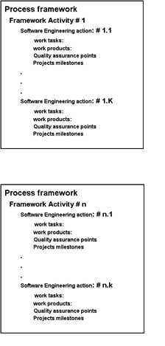
Each framework activities is populated by a set for software engineering actions – a collection of related tasks.
Each action has individual work task.

Slide 29

Communication:
  Heavy communication with customers, stakeholders, team
  Encompasses requirements gathering and related activities
Planning:
  Workflow that is to follow
  Describe technical task, likely risk, resources will require, work products to be produced and a work schedule.
Modeling:
  Help developer and customer to understand requirements (Analysis of requirements) & Design of software
Construction
  Code generation: either manual or automated or both
  Testing – to uncover error in the code.
Deployment:
  Delivery to the customer for evaluation
  Customer provide feedback

Slide 30
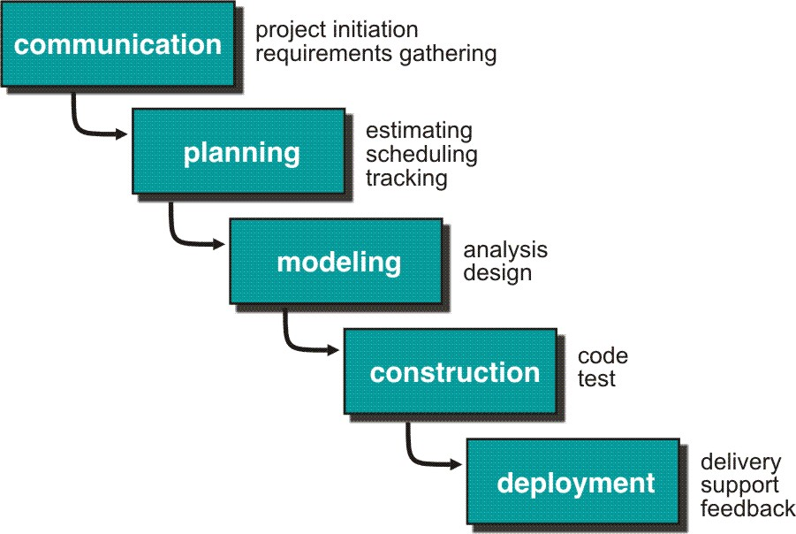

Slide 31
Software project tracking and control
  Assessing progress against the project plan.
  Take adequate action to maintain schedule.
Formal technical reviews
  Assessing software work products in an effort to uncover and remove errors before goes into next action or activity.
Software quality assurance
  Define and conducts the activities required to ensure software quality.
Software configuration management
  Manages the effects of change.

Slide 32
Document preparation and production
  Help to create work products such as models, documents, logs, form and list.
Reusability management
  Define criteria for work product reuse
  Mechanisms to achieve reusable components.
Measurement
  Define and collects process, project, and product measures
  Assist the team in delivering software that meets customer’s needs.
Risk management
  Assesses risks that may effect that outcome of project or quality of product (i.e. software)

Slide 33
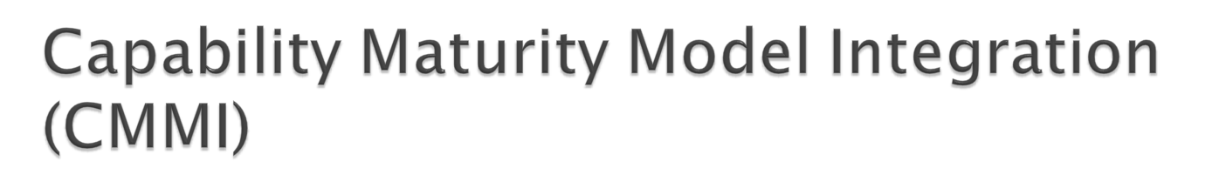
The Software Engineering Institute (SEI) has developed process meta-model to measure organization different level of process capability and maturity.
CMMI – developed by SEI
The CMMI defines each process area in terms of “specific goals” and the “specific practices” required to achieve these goals.
Specific goals establish the characteristics that must exist if the activities implied by a process area are to be effective.
Specific practices refine a goal into a set of process-related activities.

Slide 34

Level 0 (Incomplete) –
  Process are not perform or not achieve all the goals and objectives defined by the CMMI for Level I capability.
Level 1 (Performed) – All specific goals are performed as per defined by CMMI
Level 2 (Managed) –
  All level 1 criteria have been satisfied
  In addition to Level I;
    People doing work have access to adequate resources to get job done,
    Stakeholders are actively involved,
    Work tasks and products are monitored, controlled, reviewed, and evaluated for conformance to process description.
Level 3 (Defined) –
  All level 2 criteria have been achieved.
  In addition;
    management and engineering processes documented
    standardized and integrated into organization-wide software process

Slide 35

Level 4 (Quantitatively Managed) -
  All level 3 criteria have been satisfied.
  Software process and products are quantitatively understood
  Controlled using detailed measures and assessment.
Level 5 (Optimized) –
  Continuous process improvement is enabled by quantitative feedback from the process and testing innovative ideas.

Slide 36
